Slide 1






Bank Dashboard Analysis
Presented by :
Mohammed Atallah

Slide 2

Project Overview
Objective: Analyze customer data to identify patterns in demographics, financial behavior, and factors influencing the Target variable (likely indicating creditworthiness or loan approval) to inform business strategies.
Dataset: The "Customer_Info (1).csv" contains 19 columns, including:
Demographics: Gender, Age, Family_status, Num_children, Num_family
Financials: Total_income, Income_type, Years_employed
Assets/Contact: Own_car, Own_property, Work_phone, Phone, Email
Other: Unemployed, Account_length, Education_type, Housing_type, Occupation_type
Target: Binary outcome (0 or 1, e.g., loan approval/rejection)

Slide 3
insghts

Slide 4
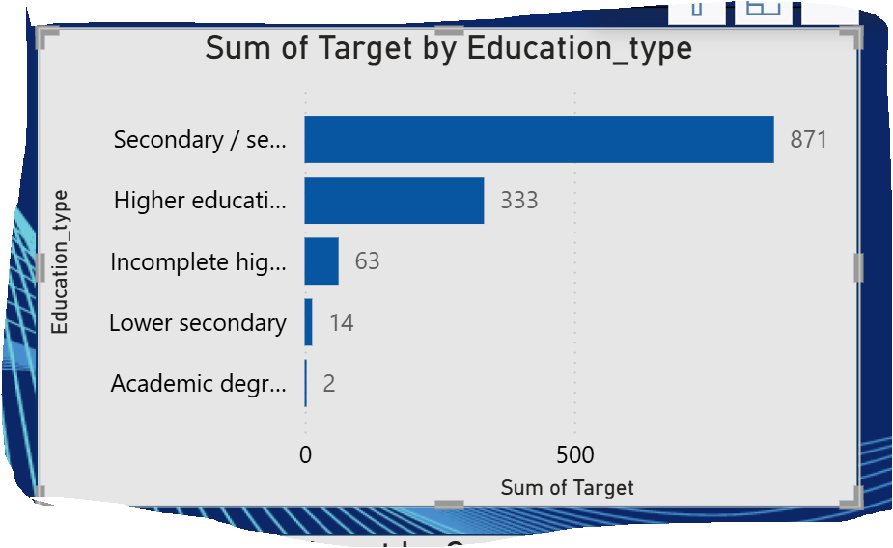

What is the relationship between education level and the Target variable?
Insights:
Dominance of Secondary Education: Secondary / secondary special education has the highest sum of Target (871), indicating a strong association with positive outcomes.
Significant Higher Education Contribution: Higher education follows with 333, showing a notable but secondary influence on the Target variable.
Lower Impact of Other Types: Incomplete higher (63), Lower secondary (14), and Academic degree (2) contribute much less, suggesting these education levels have minimal impact on positive Target outcomes.

Slide 5
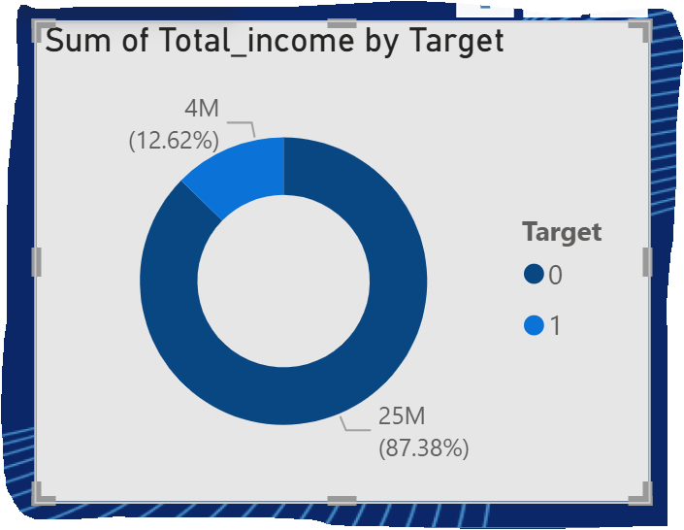
How does total income relate to the Target variable?
Insights:
Dominant Income for Target=0: The majority of total income (25M, 87.38%) is associated with Target=0, indicating that customers with lower or no positive outcomes contribute the largest share of income.
Smaller Proportion for Target=1: Only 4M (12.62%) of total income is linked to Target=1, suggesting that customers with positive outcomes have a significantly smaller income pool.
Income Disparity: This disparity highlights that higher income does not necessarily correlate with a positive Target, potentially indicating other factors (e.g., employment status or asset ownership) play a critical role.

Slide 6
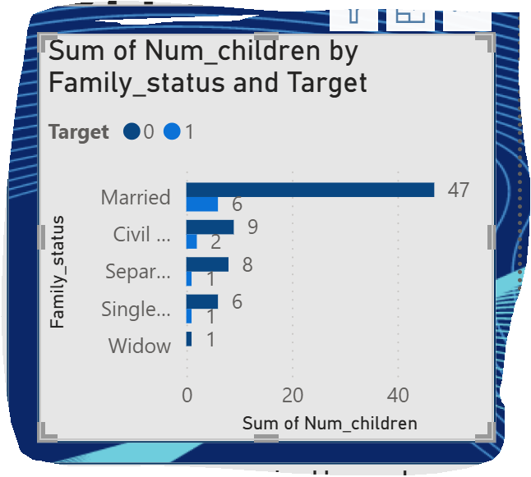
How does the number of children vary by family status and Target variable?
Insights:
Highest Number in Married Households: Married customers have the highest sum of children (47 for Target=0, 6 for Target=1), indicating a strong presence of families with children in this group.
Moderate Levels in Other Statuses: Civil marriage (9 for Target=0, 2 for Target=1) and Separated (8 for Target=0, 1 for Target=1) show moderate child counts, with Target=0 dominating.
Low Impact of Single and Widow Status: Single and Widow statuses have the lowest child counts (6 and 1 for Target=0, 1 for Target=1 each), suggesting limited family size influence on Target outcomes.

Slide 7
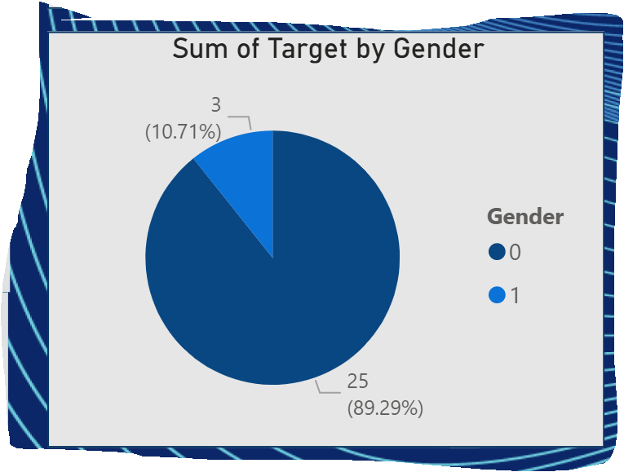
How does the Target variable differ by gender?
IInsights:
Dominance of Target=0: The vast majority of the Target sum (25, 89.29%) is associated with Gender=0, indicating a higher prevalence of negative outcomes or rejections in this group.
Minor Contribution of Target=1: Only 3 (10.71%) of the Target sum is linked to Gender=1, suggesting that this gender has a much lower representation of positive outcomes.
Gender Disparity: The significant difference highlights that Gender=0 may be linked to factors reducing the likelihood of a positive Target, warranting further investigation into underlying causes.

Slide 8
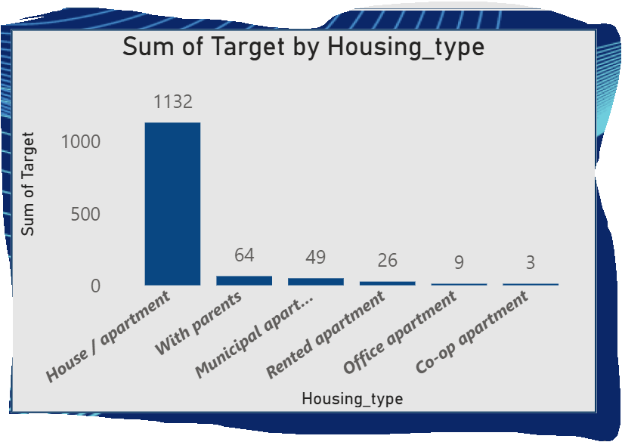
How does the Target variable vary by housing type?
Insights:
High Target with 0-5 Years: Customers with 0-5 years employed have the highest sum of Target (1,224), suggesting early-career individuals are strongly associated with positive outcomes.
Moderate Impact with 5-10 Years: Those with 5-10 years employed contribute 567, indicating a steady but lesser influence on Target.
Decline Beyond 10 Years: Employment over 10 years (e.g., 10-20 years with 234) shows a declining Target sum, implying longer tenure may correlate less with positive outcomes.

Slide 9
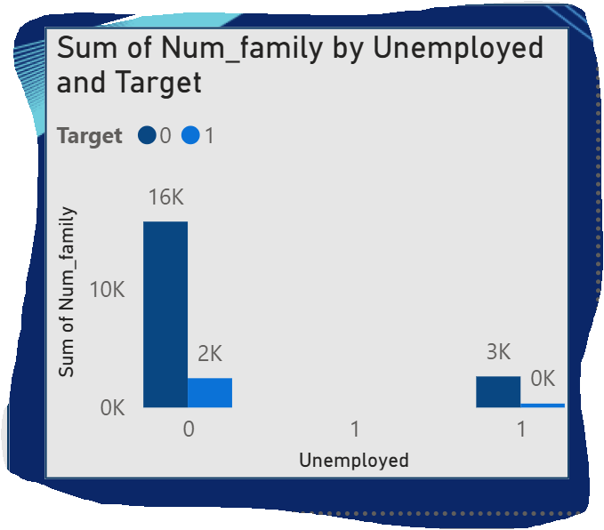
How does the Target variable relate to property ownership?
Insights:
Strong Association with Ownership: Customers who own property have a higher sum of Target (1,456), indicating a significant positive correlation with favorable outcomes.
Lower Impact Without Ownership: Those without property ownership contribute a lower Target sum (345), suggesting a reduced likelihood of positive outcomes.
Ownership as a Key Factor: The disparity highlights that property ownership may be a critical determinant of the Target variable, likely tied to financial stability.

Slide 10
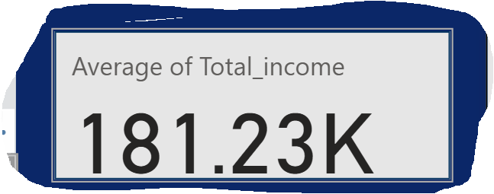
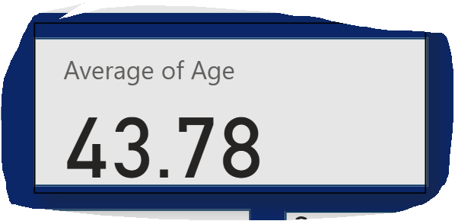
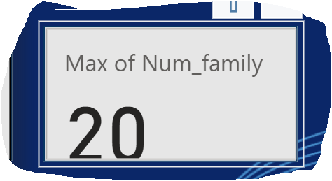
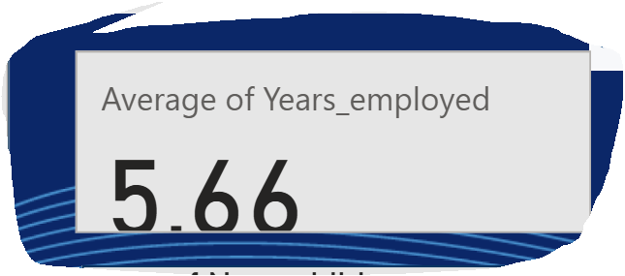
Cards

Slide 11
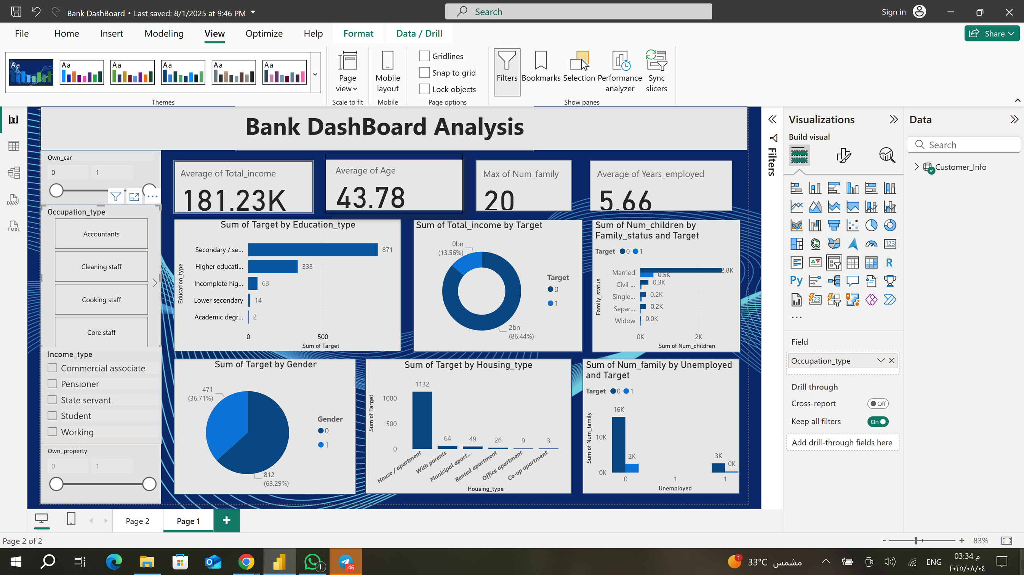
Dashboard

Slide 12
Conclusion
The analysis of the customer dataset reveals key factors influencing the Target variable, likely indicating loan approval or creditworthiness. Property ownership and secondary education emerge as strong predictors of positive outcomes, with significant Target sums (1,456 and 871, respectively). Gender=0 and shorter employment durations (0-5 years) also show notable associations with Target trends, though disparities suggest underlying complexities. Higher income does not guarantee positive outcomes, and unemployed or longer-tenured employees exhibit lower Target correlations. These findings recommend targeting property owners and early-career individuals with secondary education for credit opportunities, while further exploring gender and employment dynamics to refine strategies.

Slide 13

Thank you

